Slide 1
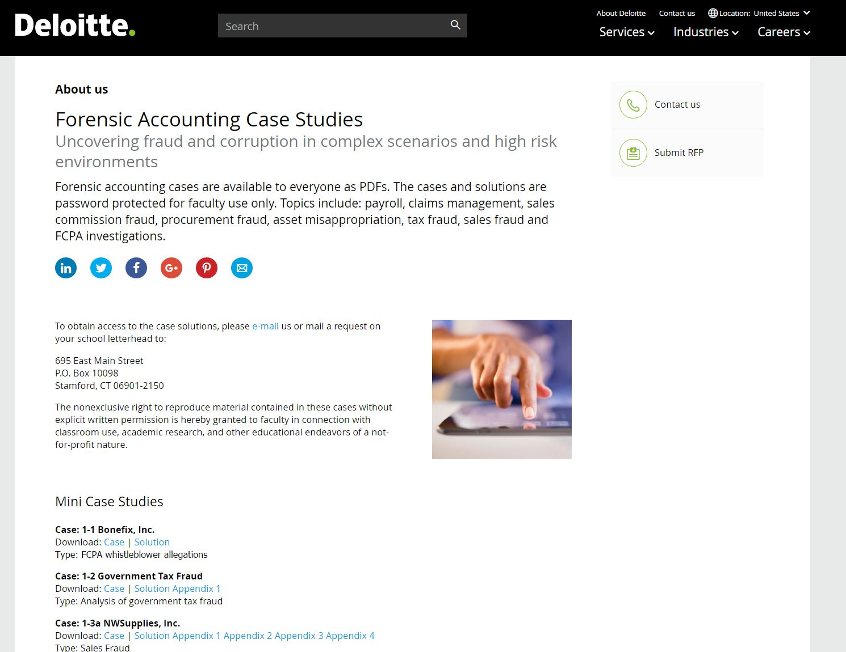
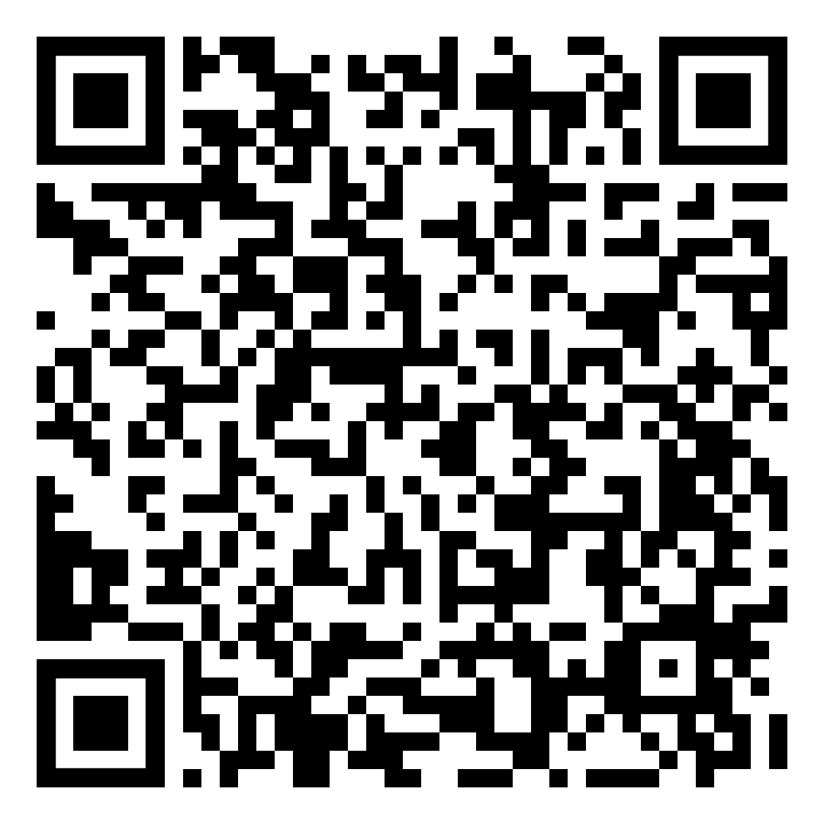
Deloitte Forensic Accounting Case Study Deep Dive and Applied Analytics The session will include a walkthrough of a forensic accounting case study to highlight a typical engagement lifecycle and analytical tools utilized to conduct an investigation.
:
Access cases using the QR code or by Googling – Deloitte Forensic Case Studies

